Slide 1
CS162 Operating Systems and Systems Programming Lecture 3 Processes (con’t), Fork, Introduction to I/O
September 2nd, 2015
Prof. John Kubiatowicz
http://cs162.eecs.Berkeley.edu

Slide 2
Recall: Four fundamental OS concepts
Thread
Single unique execution context
Program Counter, Registers, Execution Flags, Stack
Address Space w/ Translation
Programs execute in an address space that is distinct from the memory space of the physical machine
Process
An instance of an executing program is a process consisting of an address space and one or more threads of control
Dual Mode operation/Protection
Only the “system” has the ability to access certain resources
The OS and the hardware are protected from user programs and user programs are isolated from one another by controlling the translation from program virtual addresses to machine physical addresses

Slide 3
Recall: give the illusion of multiple processors?
vCPU1
vCPU2
vCPU3
vCPU1
vCPU2
vCPU3
vCPU1
vCPU2
Shared Memory
Time
Assume a single processor. How do we provide the illusion of multiple processors?
Multiplex in time!
Multiple “virtual CPUs”
Each virtual “CPU” needs a structure to hold:
Program Counter (PC), Stack Pointer (SP)
Registers (Integer, Floating point, others…?)
How switch from one virtual CPU to the next?
Save PC, SP, and registers in current state block
Load PC, SP, and registers from new state block
What triggers switch?
Timer, voluntary yield, I/O, other things

Slide 4
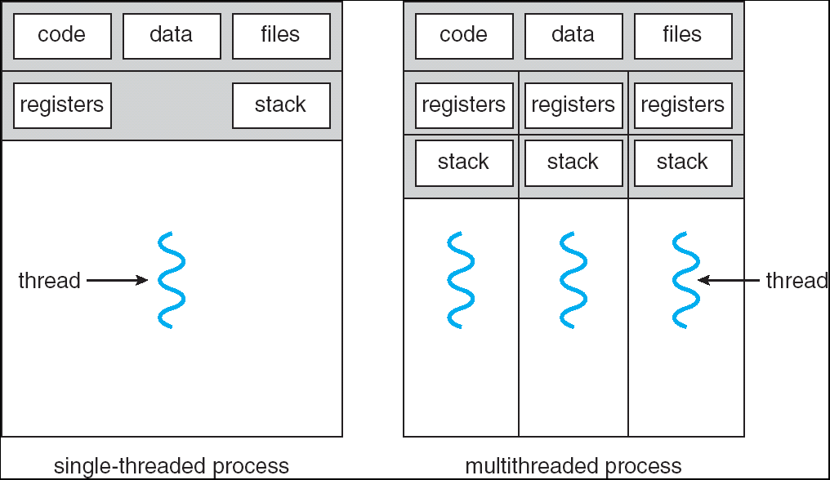
Single and Multithreaded Processes
Threads encapsulate concurrency: “Active” component
Address spaces encapsulate protection: “Passive” part
Keeps buggy program from trashing the system
Why have multiple threads per address space?
Notes:
Sometimes need parallelism for a single job, and processes are very expensive – to start, switch between, and to communicate between

Slide 5
Running Many Programs
We have the basic mechanism to
switch between user processes and the kernel,
the kernel can switch among user processes,
Protect OS from user processes and processes from each other
Questions ???
How do we represent user processes in the OS?
How do we decide which user process to run?
How do we pack up the process and set it aside?
How do we get a stack and heap for the kernel?
Aren’t we wasting are lot of memory?
…

Slide 6
Process Control Block
Kernel represents each process as a process control block (PCB)
Status (running, ready, blocked, …)
Register state (when not ready)
Process ID (PID), User, Executable, Priority, …
Execution time, …
Memory space, translation, …
Kernel Scheduler maintains a data structure containing the PCBs
Scheduling algorithm selects the next one to run

Slide 7
Scheduler
if ( readyProcesses(PCBs) ) {
nextPCB = selectProcess(PCBs);
run( nextPCB );
} else {
run_idle_process();
}
Scheduling: Mechanism for deciding which processes/threads receive the CPU
Lots of different scheduling policies provide …
Fairness or
Realtime guarantees or
Latency optimization or ..

Slide 8
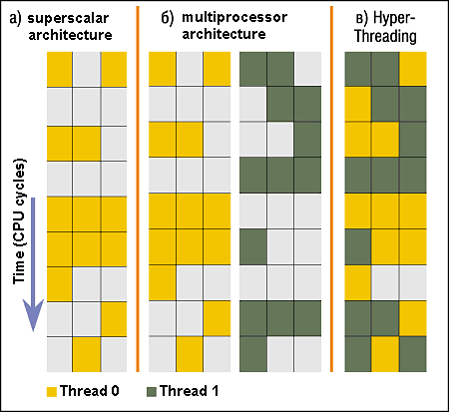
Simultaneous MultiThreading/Hyperthreading
Hardware technique
Superscalar processors can execute multiple instructions that are independent.
Hyperthreading duplicates register state to make a second “thread,” allowing more instructions to run.
Can schedule each thread as if were separate CPU
But, sub-linear speedup!
Original technique called “Simultaneous Multithreading”
http://www.cs.washington.edu/research/smt/index.html
SPARC, Pentium 4/Xeon (“Hyperthreading”), Power 5
Colored blocks show
instructions executed
Notes:
Intel seems to be discarding SMT in Silvermont because of power problems

Slide 9
Recall: A simple address translation (B&B)
0000…
0000…
code
code
Static Data
Static Data
heap
heap
stack
Base Address
stack
1000…
1000…
code
Program
address
Static Data
heap
Bound
<
stack
1100…
0100…
Can the program touch OS?
Can it touch other programs?
FFFF…

Slide 10
Simple B&B: User code running
0000…
Proc 1
Proc 2
Proc n
code
…
Static Data
OS
heap
stack
sysmode
0
1000…
code
Base
1000 …
0000…
Static Data
Bound
1100…
FFFF…
heap
uPC
xxxx…
stack
1100…
PC
0000 1234
How does kernel switch between processes?
First question: How to return to system?
3000…
regs
code
00FF…
Static Data
…
heap
stack
3080…
FFFF…

Slide 11
Simple B&B: Interrupt
0000…
Proc 1
Proc 2
Proc n
code
…
Static Data
OS
heap
stack
sysmode
1
1000…
code
Base
1000 …
0000…
Static Data
Bound
1100 …
FFFF…
heap
uPC
0000 1234
stack
1100…
PC
IntrpVector[i]
code
3000…
regs
00FF…
Static Data
…
heap
stack
3080…
FFFF…

Slide 12
Simple B&B: Switch User Process
0000…
Proc 1
Proc 2
Proc n
code
RTU
…
Static Data
OS
heap
stack
sysmode
1
1000…
1000 …
code
Base
3000 …
0000…
Static Data
1100 …
Bound
0080 …
FFFF…
heap
0000 1234
uPC
0000 0248
regs
stack
1100…
PC
0001 0124
00FF…
code
3000…
regs
00D0…
Static Data
How to save registers and set up system stack?
…
heap
stack
3080…
FFFF…

Slide 13
Simple B&B: “resume”
0000…
Proc 1
Proc 2
Proc n
code
RTU
…
Static Data
OS
heap
stack
sysmode
0
1000…
1000 …
code
Base
3000 …
0000…
Static Data
1100 …
Bound
0080 …
FFFF…
heap
0000 1234
uPC
xxxx xxxx
regs
stack
1100…
PC
000 0248
00FF…
code
3000…
regs
00D0…
Static Data
…
heap
stack
3080…
FFFF…

Slide 14
What’s wrong with this simplistic address translation mechanism?
Fragmentation:
Kernel has to somehow fit whole processes into contiguous block of memory
After a while, memory becomes fragmented!
Sharing:
Very hard to share any data between Processes or between Process and Kernel
Simple segmentation

Slide 15
x86 – segments and stacks
code
Static Data
Processor Registers
heap
CS
EIP
stack
SS
ESP
CS:
EIP:
code
EAX
DS
EBX
ES
ECX
Static Data
EDX
ESI
EDI
heap
Start address, length and access rights associated with each segment
SS:
ESP:
stack

Slide 16
Alternative: Address Mapping
Code
Data
Heap
Stack
Data 2
Code
Data
Heap
Stack
Stack 1
Heap 1
Code 1
Stack 2
Prog 1
Virtual
Address
Space 1
Data 1
Prog 2
Virtual
Address
Space 2
Heap 2
Code 2
OS code
Translation Map 1
OS data
Translation Map 2
OS heap &
Stacks
Physical Address Space

Slide 17
Administrivia: Getting started
Kubiatowicz Office Hours:
1pm-2pm, Monday/Wednesday
Homework 0 immediately ⇒ Due on Monday!
Get familiar with all the cs162 tools
Submit to autograder via git
Should be going to section already!
Participation: Get to know your TA!
Friday is Drop Deadline!
Group sign up form out next week (after drop deadine)
Get finding groups ASAP
4 people in a group! Try to keep same section; if cannot make this work, keep same TA

Slide 18
Administrivia (Con’t)
Conflict between Midterm 2 and EE16A
We are thinking of moving Midterm 2 from Wed 11/18
Posibilites: Mon 11/23 (my favorite) or Mon 11/16
Midterm 1 conflicts
I know about one problem with Midterm 1 scheduling, and it can be dealt with. Have I missed any others?
Finals conflicts: We will not be moving the exam or providing makeup finals…
I don’t know of any current conflicts
If you have a significant conflict that you think should cause us to change our policy, let me know now (note that CS186 is not conflicting any more).

Slide 19
Recall: 3 types of Kernel Mode Transfer
Syscall
Process requests a system service, e.g., exit
Like a function call, but “outside” the process
Does not have the address of the system function to call
Like a Remote Procedure Call (RPC) – for later
Marshall the syscall id and args in registers and exec syscall
Interrupt
External asynchronous event triggers context switch
eg. Timer, I/O device
Independent of user process
Trap or Exception
Internal synchronous event in process triggers context switch
e.g., Protection violation (segmentation fault), Divide by zero, …

Slide 20
Recall: User/Kernal(Priviledged) Mode
User Mode
interrupt
exception
syscall
rtn
rfi
Kernel Mode
exit
exec
Limited HW access
Full HW access

Slide 21
Implementing Safe Kernel Mode Transfers
Important aspects:
Separate kernel stack
Controlled transfer into kernel (e.g. syscall table)
Carefully constructed kernel code packs up the user process state and sets it aside.
Details depend on the machine architecture
Should be impossible for buggy or malicious user program to cause the kernel to corrupt itself.

Slide 22
Need for Separate Kernel Stacks
Kernel needs space to work
Cannot put anything on the user stack (Why?)
Two-stack model
OS thread has interrupt stack (located in kernel memory) plus User stack (located in user memory)
Syscall handler copies user args to kernel space before invoking specific function (e.g., open)
Interrupts (???)

Slide 23
Before

Slide 24
During

Slide 25
Kernel System Call Handler
Vector through well-defined syscall entry points!
Table mapping system call number to handler
Locate arguments
In registers or on user(!) stack
Copy arguments
From user memory into kernel memory
Protect kernel from malicious code evading checks
Validate arguments
Protect kernel from errors in user code
Copy results back
into user memory

Slide 26
Hardware support: Interrupt Control
Interrupt processing not be visible to the user process:
Occurs between instructions, restarted transparently
No change to process state
What can be observed even with perfect interrupt processing?
Interrupt Handler invoked with interrupts ‘disabled’
Re-enabled upon completion
Non-blocking (run to completion, no waits)
Pack up in a queue and pass off to an OS thread for hard work
wake up an existing OS thread
OS kernel may enable/disable interrupts
On x86: CLI (disable interrupts), STI (enable)
Atomic section when select next process/thread to run
Atomic return from interrupt or syscall
HW may have multiple levels of interrupt
Mask off (disable) certain interrupts, eg., lower priority
Certain non-maskable-interrupts (nmi)
e.g., kernel segmentation fault

Slide 27
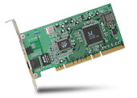
Interrupt Controller
Interrupt Mask
Priority Encoder
IntID
CPU
Interrupt
Int Disable
Timer
Software
Interrupt
Control
NMI
Network
Interrupts invoked with interrupt lines from devices
Interrupt controller chooses interrupt request to honor
Mask enables/disables interrupts
Priority encoder picks highest enabled interrupt
Software Interrupt Set/Cleared by Software
Interrupt identity specified with ID line
CPU can disable all interrupts with internal flag
Non-maskable interrupt line (NMI) can’t be disabled

Slide 28
How do we take interrupts safely?
Interrupt vector
Limited number of entry points into kernel
Kernel interrupt stack
Handler works regardless of state of user code
Interrupt masking
Handler is non-blocking
Atomic transfer of control
“Single instruction”-like to change:
Program counter
Stack pointer
Memory protection
Kernel/user mode
Transparent restartable execution
User program does not know interrupt occurred

Slide 29
Putting it together: web server
syscall
syscall
RTU
RTU
wait
wait
interrupt
interrupt

Slide 30
Can a process create a process ?
Yes
Unique identity of process is the “process ID” (or pid).
Fork() system call creates a copy of current process with a new pid
Return value from Fork(): integer
When > 0:
Running in (original) Parent process
return value is pid of new child
When = 0:
Running in new Child process
When < 0:
Error! Must handle somehow
Running in original process
All of the state of original process duplicated in both Parent and Child!
Memory, File Descriptors (next topic), etc…

Slide 31
fork1.c
#include <stdlib.h>
#include <stdio.h>
#include <string.h>
#include <unistd.h>
#include <sys/types.h>
#define BUFSIZE 1024
int main(int argc, char *argv[])
{
char buf[BUFSIZE];
size_t readlen, writelen, slen;
pid_t cpid, mypid;
pid_t pid = getpid(); /* get current processes PID */
printf("Parent pid: %d\n", pid);
cpid = fork();
if (cpid > 0) { /* Parent Process */
mypid = getpid();
printf("[%d] parent of [%d]\n", mypid, cpid);
} else if (cpid == 0) { /* Child Process */
mypid = getpid();
printf("[%d] child\n", mypid);
} else {
perror("Fork failed");
exit(1);
}
exit(0);
}

Slide 32
UNIX Process Management
UNIX fork – system call to create a copy of the current process, and start it running
No arguments!
UNIX exec – system call to change the program being run by the current process
UNIX wait – system call to wait for a process to finish
UNIX signal – system call to send a notification to another process
Notes:
UNIX splits creating a process into two steps, each of them a lot simpler.

Slide 33
fork2.c
int status;
…
cpid = fork();
if (cpid > 0) { /* Parent Process */
mypid = getpid();
printf("[%d] parent of [%d]\n", mypid, cpid);
tcpid = wait(&status);
printf("[%d] bye %d(%d)\n", mypid, tcpid, status);
} else if (cpid == 0) { /* Child Process */
mypid = getpid();
printf("[%d] child\n", mypid);
}
…

Slide 34
UNIX Process Management
Notes:
How is this used – typically, fork a process, child and parent are now both running the same program. One sets up the child program, and runs exec – becoming the new program
The parent, usually, waits for the child to finish

Slide 35
Shell
A shell is a job control system
Allows programmer to create and manage a set of programs to do some task
Windows, MacOS, Linux all have shells
Example: to compile a C program
cc –c sourcefile1.c
cc –c sourcefile2.c
ln –o program sourcefile1.o sourcefile2.o
./program
HW1

Slide 36
Signals – infloop.c
#include <stdlib.h>
#include <stdio.h>
#include <sys/types.h>
#include <unistd.h>
#include <signal.h>
void signal_callback_handler(int signum)
{
printf("Caught signal %d - phew!\n",signum);
exit(1);
}
int main() {
signal(SIGINT, signal_callback_handler);
while (1) {}
}
Got top?

Slide 37
Process races: fork.c
if (cpid > 0) {
mypid = getpid();
printf("[%d] parent of [%d]\n", mypid, cpid);
for (i=0; i<100; i++) {
printf("[%d] parent: %d\n", mypid, i);
// sleep(1);
}
} else if (cpid == 0) {
mypid = getpid();
printf("[%d] child\n", mypid);
for (i=0; i>-100; i--) {
printf("[%d] child: %d\n", mypid, i);
// sleep(1);
}
}
Question: What does this program print?
Does it change if you add in one of the sleep() statements?

Slide 38
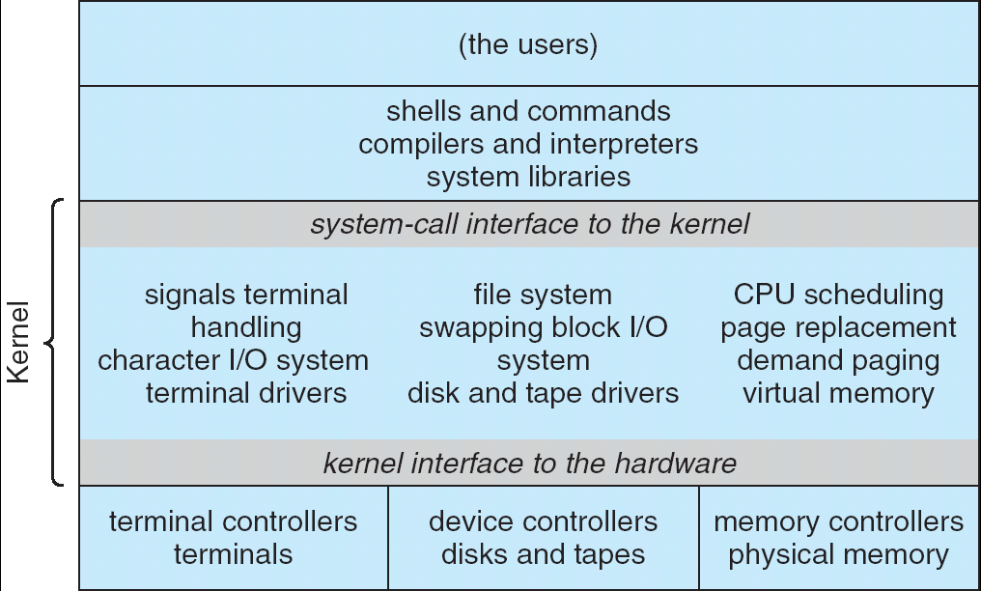
Recall: UNIX System Structure
Applications
User Mode
Standard Libs
Kernel Mode
Hardware

Slide 39
How does the kernel provide services?
You said that applications request services from the operating system via syscall, but …
I’ve been writing all sort of useful applications and I never ever saw a “syscall” !!!
That’s right.
It was buried in the programming language runtime library (e.g., libc.a)
… Layering

Slide 40
OS run-time library
Proc 1
Proc 2
Proc n
…
OS
Appln
login
Window Manager
…
OS library
OS library
OS library
OS

Slide 41
A Kind of Narrow Waist
Word Processing
Compilers
Web Browsers
Email
Databases
Web Servers
Application / Service
Portable OS Library
OS
User
System Call
Interface
System
Portable OS Kernel
Software
Platform support, Device Drivers
Hardware
x86
PowerPC
ARM
PCI
Ethernet (10/100/1000)
802.11 a/b/g/n
SCSI
IDE
Graphics

Slide 42
Key Unix I/O Design Concepts
Uniformity
file operations, device I/O, and interprocess communication through open, read/write, close
Allows simple composition of programs
find | grep | wc …
Open before use
Provides opportunity for access control and arbitration
Sets up the underlying machinery, i.e., data structures
Byte-oriented
Even if blocks are transferred, addressing is in bytes
Kernel buffered reads
Streaming and block devices looks the same
read blocks process, yielding processor to other task
Kernel buffered writes
Completion of out-going transfer decoupled from the application, allowing it to continue
Explicit close

Slide 43
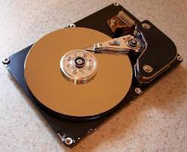
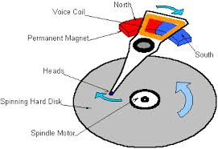
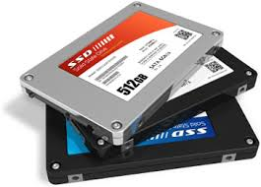

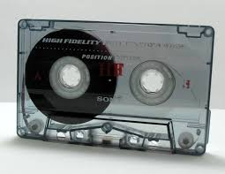
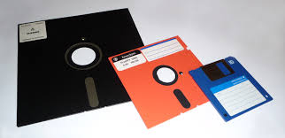
I/O & Storage Layers
Application / Service
streams
High Level I/O
Low Level I/O
handles
Syscall
registers
File System
descriptors
I/O Driver
Commands and Data Transfers
Disks, Flash, Controllers, DMA

Slide 44
The file system abstraction
File
Named collection of data in a file system
File data
Text, binary, linearized objects
File Metadata: information about the file
Size, Modification Time, Owner, Security info
Basis for access control
Directory
“Folder” containing files & Directories
Hierachical (graphical) naming
Path through the directory graph
Uniquely identifies a file or directory
/home/ff/cs162/public_html/fa14/index.html
Links and Volumes (later)

Slide 45
C high level File API – streams (review)
Operate on “streams” - sequence of bytes, whether text or data, with a position
#include <stdio.h>
FILE *fopen( const char *filename, const char *mode );
int fclose( FILE *fp );
Mode Text | Binary | Descriptions
r | rb | Open existing file for reading
w | wb | Open for writing; created if does not exist
a | ab | Open for appending; created if does not exist
r+ | rb+ | Open existing file for reading & writing.
w+ | wb+ | Open for reading & writing; truncated to zero if exists, create otherwise
a+ | ab+ | Open for reading & writing. Created if does not exist. Read from beginning, write as append
Don’t forget to flush

Slide 46
Connecting Processes, Filesystem, and Users
Process has a ‘current working directory’
Absolute Paths
/home/ff/cs152
Relative paths
index.html, ./index.html - current WD
../index.html - parent of current WD
~, ~cs152 - home directory

Slide 47
C API Standard Streams
Three predefined streams are opened implicitly when the program is executed.
FILE *stdin – normal source of input, can be redirected
FILE *stdout – normal source of output, can too
FILE *stderr – diagnostics and errors
STDIN / STDOUT enable composition in Unix
Recall: Use of pipe symbols connects STDOUT and STDIN
find | grep | wc …

Slide 48
C high level File API – stream ops
#include <stdio.h>
// character oriented
int fputc( int c, FILE *fp ); // rtn c or EOF on err
int fputs( const char *s, FILE *fp ); // rtn >0 or EOF
int fgetc( FILE * fp );
char *fgets( char *buf, int n, FILE *fp );
// block oriented
size_t fread(void *ptr, size_t size_of_elements,
size_t number_of_elements, FILE *a_file);
size_t fwrite(const void *ptr, size_t size_of_elements,
size_t number_of_elements, FILE *a_file);
// formatted
int fprintf(FILE *restrict stream, const char *restrict format, ...);
int fscanf(FILE *restrict stream, const char *restrict format, ... );

Slide 49
C Stream API positioning
int fseek(FILE *stream, long int offset, int whence); long int ftell (FILE *stream)
void rewind (FILE *stream)
Preserves high level abstraction of a uniform stream of objects
Adds buffering for performance

Slide 50
What’s below the surface ??
Application / Service
streams
High Level I/O
Low Level I/O
handles
Syscall
registers
File System
descriptors
I/O Driver
Commands and Data Transfers
Disks, Flash, Controllers, DMA

Slide 51
C Low level I/O
Operations on File Descriptors – as OS object representing the state of a file
User has a “handle” on the descriptor
#include <fcntl.h>
#include <unistd.h>
#include <sys/types.h>
int open (const char *filename, int flags [, mode_t mode])
int creat (const char *filename, mode_t mode)
int close (int filedes)
Bit vector of:
Access modes (Rd, Wr, …)
Open Flags (Create, …)
Operating modes (Appends, …)
Bit vector of Permission Bits:
User|Group|Other X R|W|X
http://www.gnu.org/software/libc/manual/html_node/Opening-and-Closing-Files.html

Slide 52
C Low Level: standard descriptors
#include <unistd.h>
STDIN_FILENO - macro has value 0
STDOUT_FILENO - macro has value 1
STDERR_FILENO - macro has value 2
int fileno (FILE *stream)
FILE * fdopen (int filedes, const char *opentype)
Crossing levels: File descriptors vs. streams
Don’t mix them!

Slide 53
C Low Level Operations
ssize_t read (int filedes, void *buffer, size_t maxsize)
- returns bytes read, 0 => EOF, -1 => error
ssize_t write (int filedes, const void *buffer, size_t size)
- returns bytes written
off_t lseek (int filedes, off_t offset, int whence)
int fsync (int fildes) – wait for i/o to finish
void sync (void) – wait for ALL to finish
When write returns, data is on its way to disk and can be read, but it may not actually be permanent!

Slide 54
And lots more !
TTYs versus files
Memory mapped files
File Locking
Asynchronous I/O
Generic I/O Control Operations
Duplicating descriptors
int dup2 (int old, int new)
int dup (int old)

Slide 55
What’s below the surface ??
Application / Service
streams
High Level I/O
Low Level I/O
handles
Syscall
registers
File System
descriptors
I/O Driver
Commands and Data Transfers
Disks, Flash, Controllers, DMA

Slide 56
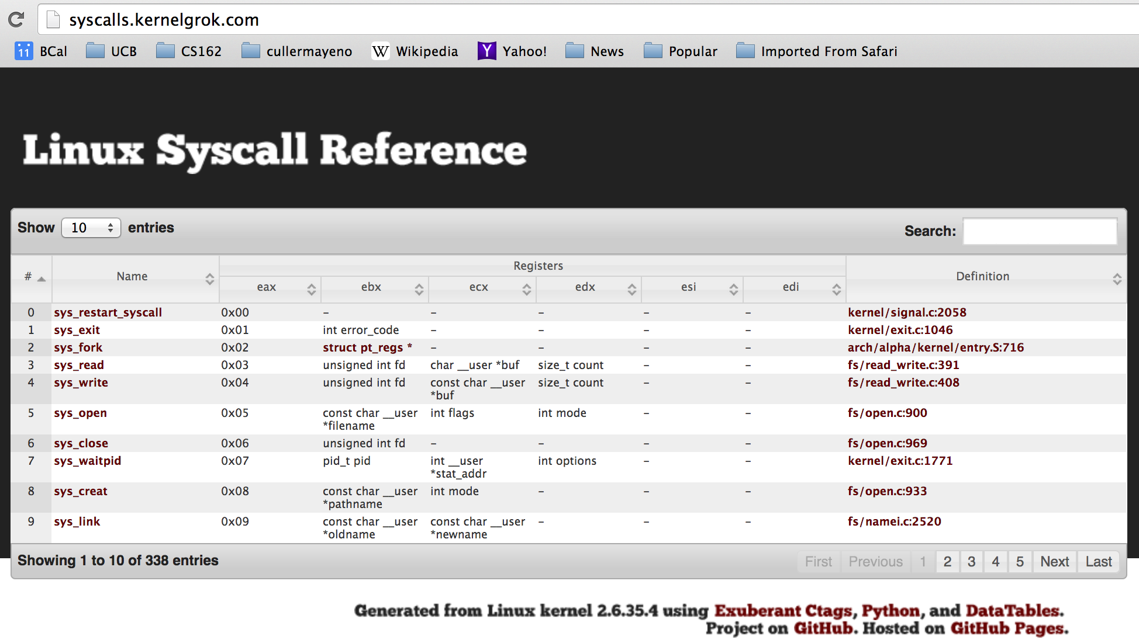
SYSCALL
Low level lib parameters are set up in registers and syscall instruction is issued
A type of synchronous exception that enters well-defined entry points into kernel

Slide 57
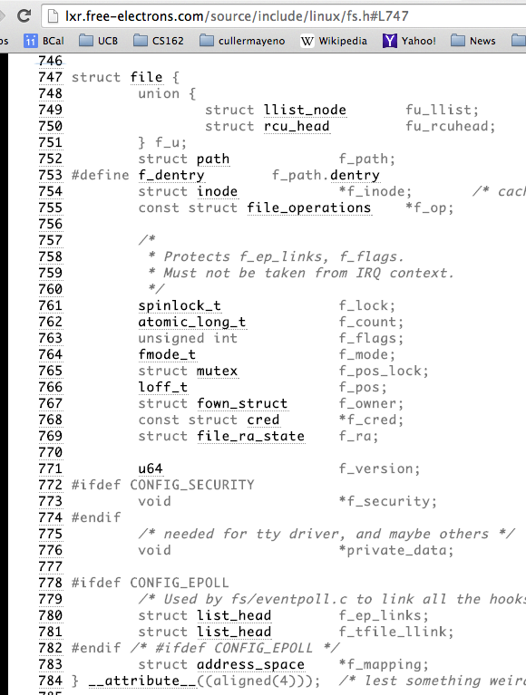
Internal OS File Descriptor
Internal Data Structure describing everything about the file
Where it resides
Its status
How to access it

Slide 58
Device Drivers
Device Driver: Device-specific code in the kernel that interacts directly with the device hardware
Supports a standard, internal interface
Same kernel I/O system can interact easily with different device drivers
Special device-specific configuration supported with the ioctl() system call
Device Drivers typically divided into two pieces:
Top half: accessed in call path from system calls
implements a set of standard, cross-device calls like open(), close(), read(), write(), ioctl(), strategy()
This is the kernel’s interface to the device driver
Top half will start I/O to device, may put thread to sleep until finished
Bottom half: run as interrupt routine
Gets input or transfers next block of output
May wake sleeping threads if I/O now complete

Slide 59
File System: from syscall to driver
In fs/read_write.c
ssize_t vfs_read(struct file *file, char __user *buf, size_t count, loff_t *pos)
{
ssize_t ret;
if (!(file->f_mode & FMODE_READ)) return -EBADF;
if (!file->f_op || (!file->f_op->read && !file->f_op->aio_read))
return -EINVAL;
if (unlikely(!access_ok(VERIFY_WRITE, buf, count))) return -EFAULT;
ret = rw_verify_area(READ, file, pos, count);
if (ret >= 0) {
count = ret;
if (file->f_op->read)
ret = file->f_op->read(file, buf, count, pos);
else
ret = do_sync_read(file, buf, count, pos);
if (ret > 0) {
fsnotify_access(file->f_path.dentry);
add_rchar(current, ret);
}
inc_syscr(current);
}
return ret;
}

Slide 60
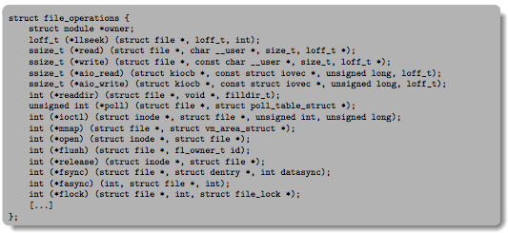
Low Level Driver
Associated with particular hardware device
Registers / Unregisters itself with the kernel
Handler functions for each of the file operations

Slide 61
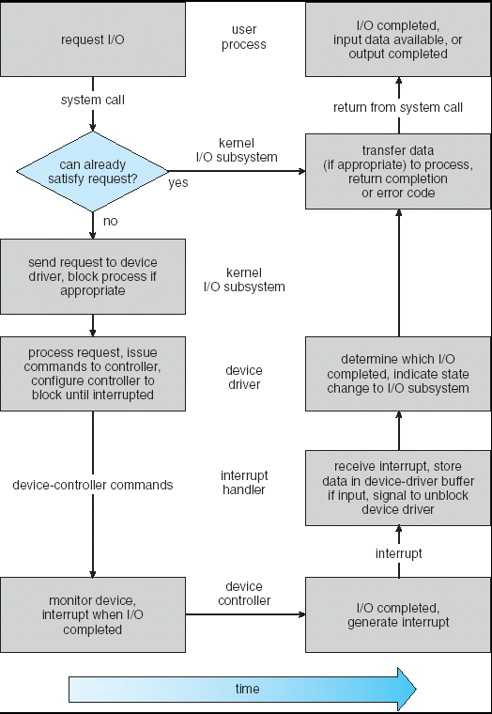
Life Cycle of An I/O Request
User
Program
Kernel I/O
Subsystem
Device Driver
Top Half
Device Driver
Bottom Half
Device
Hardware

Slide 62
So what happens when you fgetc?
Application / Service
streams
High Level I/O
handles
Low Level I/O
registers
Syscall
File System
descriptors
I/O Driver
Commands and Data Transfers
Disks, Flash, Controllers, DMA

Slide 63
Summary
Process: execution environment with Restricted Rights
Address Space with One or More Threads
Owns memory (address space)
Owns file descriptors, file system context, …
Encapsulate one or more threads sharing process resources
Interrupts
Hardware mechanism for regaining control from user
Notification that events have occurred
User-level equivalent: Signals
Native control of Process
Fork, Exec, Wait, Signal
Basic Support for I/O
Standard interface: open, read, write, seek
Device drivers: customized interface to hardware

